Slide 1
The Use of Hybrid Clouding to Reduce the Cost of Database Management System
Team Members: Nghi Nguyen & Rudra Gandhi

Slide 2
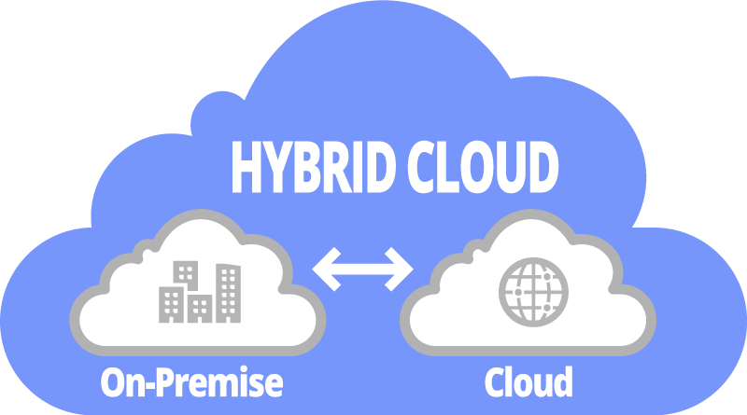
Introduction

Slide 3
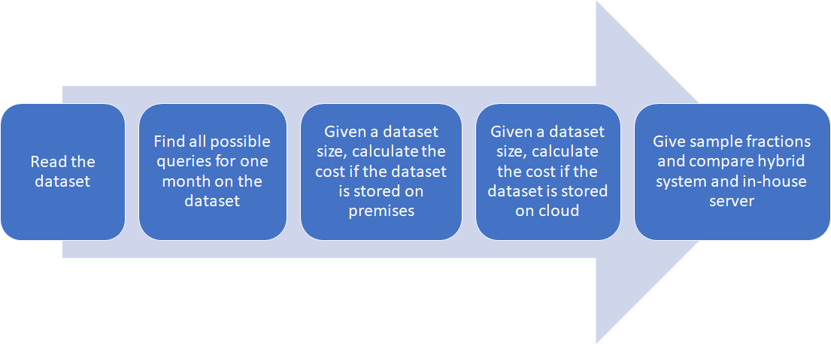
Design/Flowchart

Slide 4
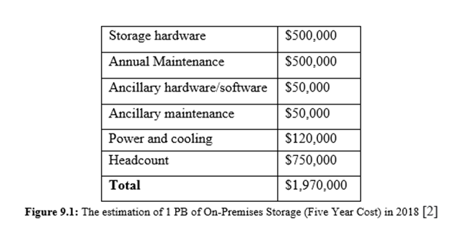
On-premises cost
$0.034/GB/MONTH --> $0.0427/GB/month

Slide 5
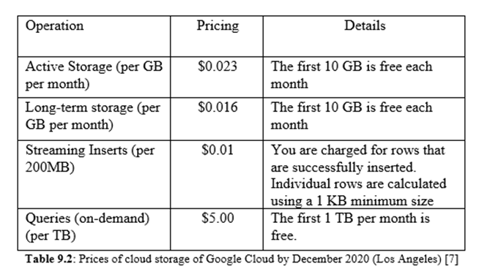
Cloud cost = storage cost + query cost
$0.023/gb/month + query cost

Slide 6
Query cost
Queries include:
Insert
Join table
Select with condition
Sort data
Display the entire data
→ $0.278817 per user per month for a dataset of 375.387 GBs
→ Assume 30 users → $3.36431 per month for 30 users

Slide 7
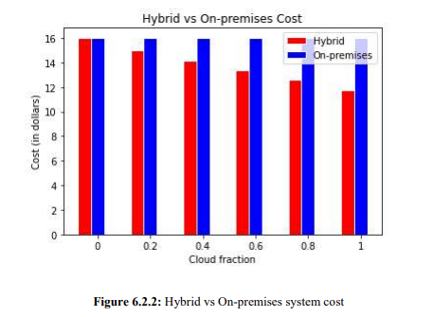
Output generation and Analysis

Slide 8
Compare output against hypothesis
→ Through our experiments, we can conclude that we are failed to reject our null hypothesis.

Slide 9
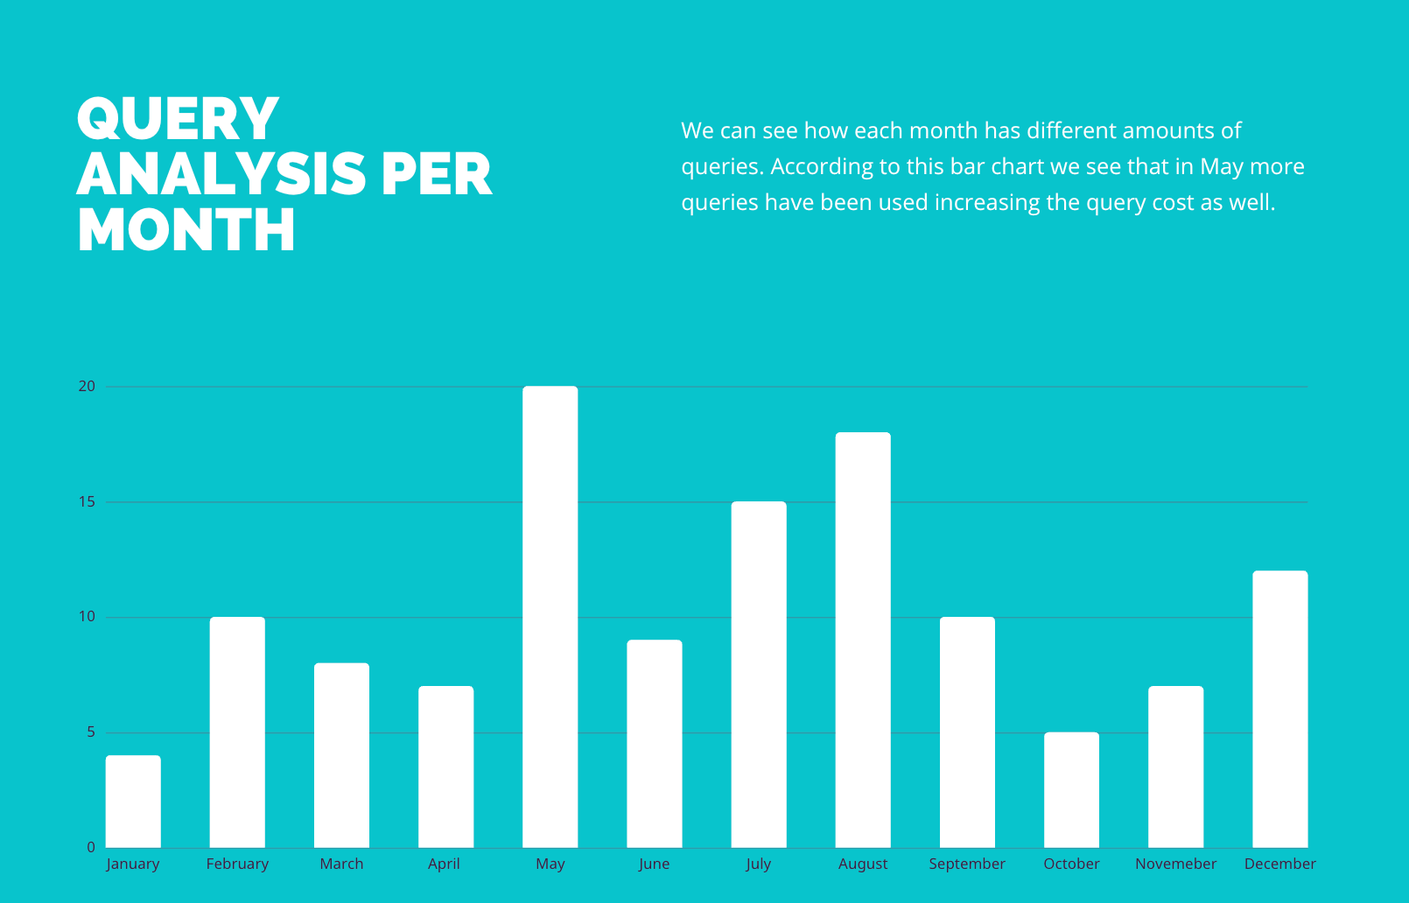
Abnormal Case Explanation
The abnormal case is when the query cost is too high
A data analyst in one month runs more queries than a normal month, then there will be a significant difference in the monthly costs and can affect the teams budgets

Slide 10
Discussion
Advantages:
Agility: The need to adapt and change direction quickly
Hybrid cloud has the benefit of being cost-effective as organizations pay for the public cloud position of their infrastructure only when it is needed.
Disadvantage:
A fast performing on-premise infrastructure may not be able to successfully perform in coherence with a slow-performing public infrastructure resulting in a sluggish performance of the Hybrid Cloud.

Slide 11
Conclusion
The results of the analysis say that the cloud database management may be costly if we continuously run the queries too many times. However, if we just save the data for backup or not run so many quereis, cloud database is a much cheaper system.
Allows enterprises to take advantage of cloud services and free up personnel to concentrate on other assignments.
Finally, through our experiment and logical analysis we still propose a hybrid clouding system with a low portion of private database stored on-premises data center and higher portion of public database stored on cloud.

Slide 12
DEMO TIME!

